Slide 1
Structural Variants (SVs) and Copy Number Variants (CNVs) using short-read May 4 2025 Slide adapted from Dr. Tobias Rausch - EMBL
Phuc Loi Luu, PhD
Email: Luu.p.loi@googlemail.com
Zalo: 090102182

Slide 2
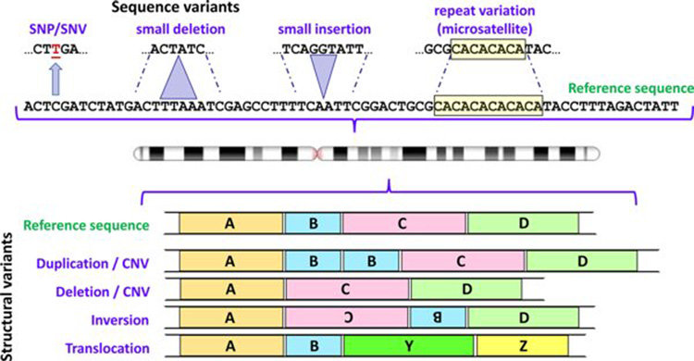
Type of variants
10.1042/EBC20170053

Slide 3
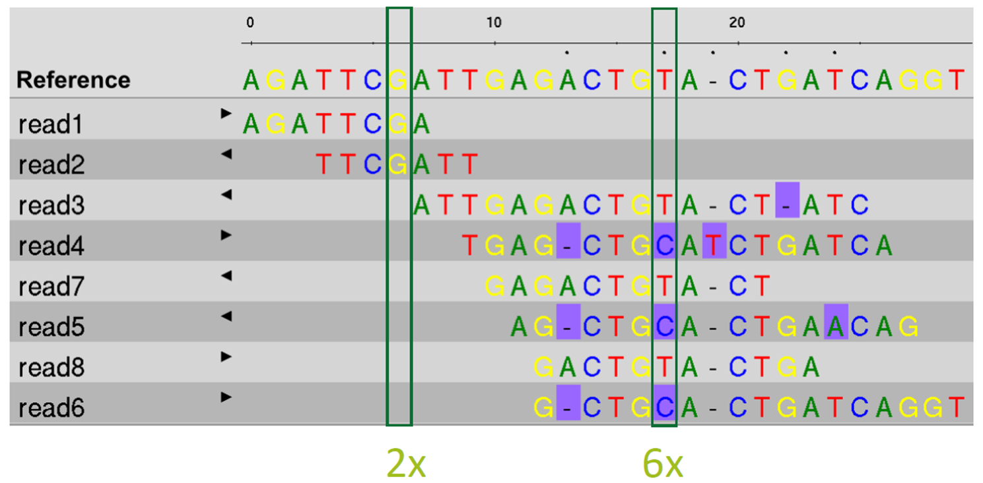
SNP and SNV
1
3
4
2

Slide 4
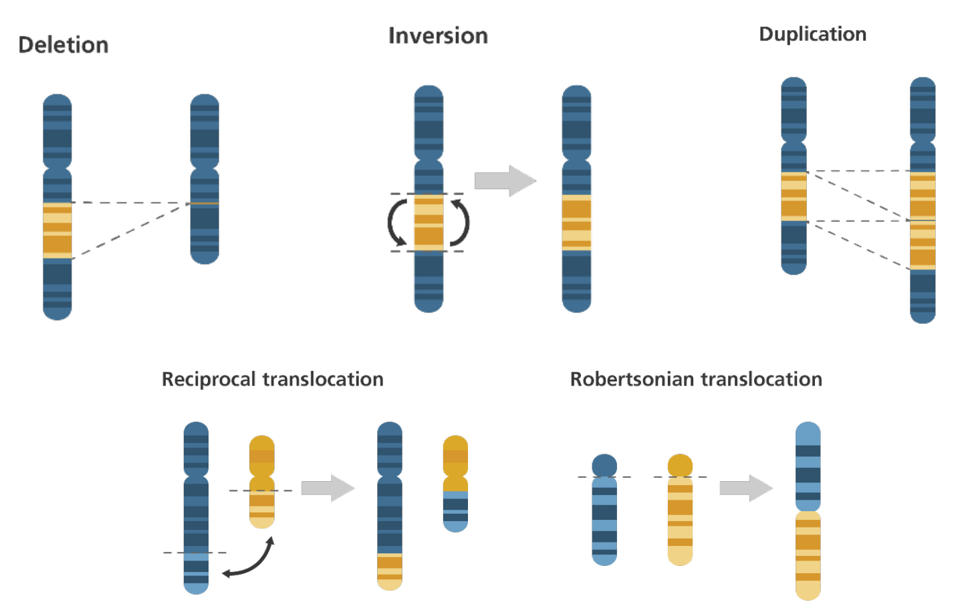
Somatic and Germline Structural Variants (SVs)

Slide 5
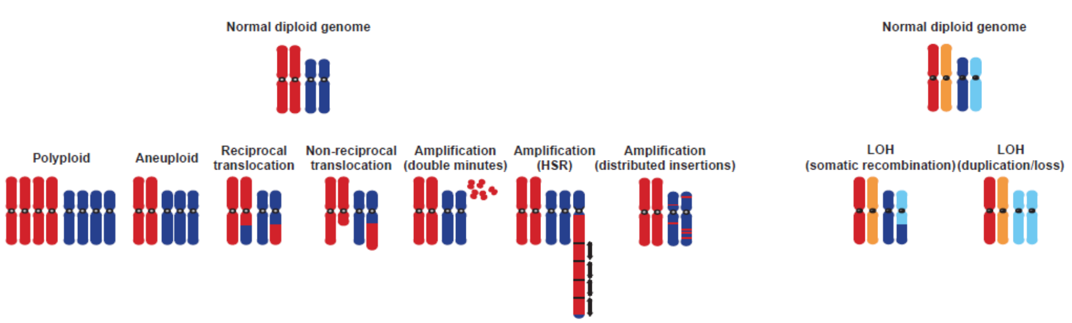
Cancers harbour a wide Range of Chromosome Aberrations
Chromosome aberrations in solid tumors. Albertson et al., Nat Genet. 2003 Aug;34(4):369-76.

Slide 6
Structural Variants (SVs)

Slide 7
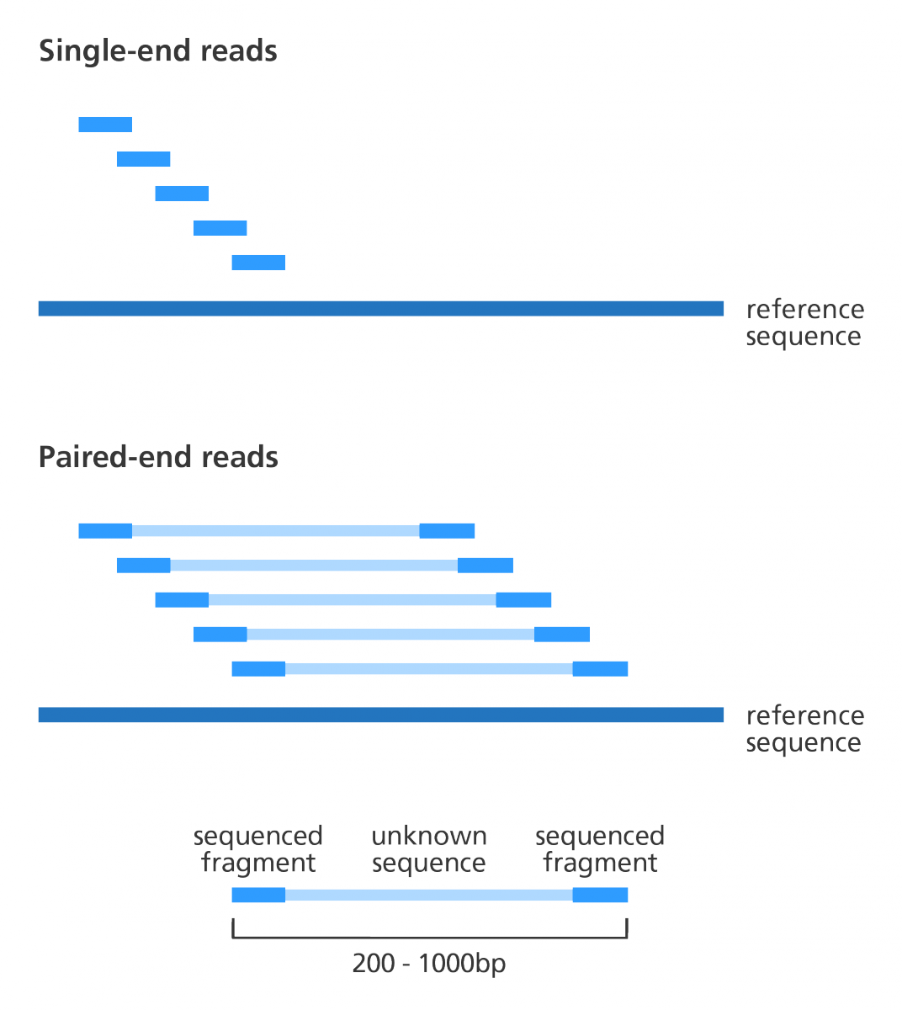
Single-End vs Paired-End Sequencing
Image by Genome Research Ltd

Slide 8
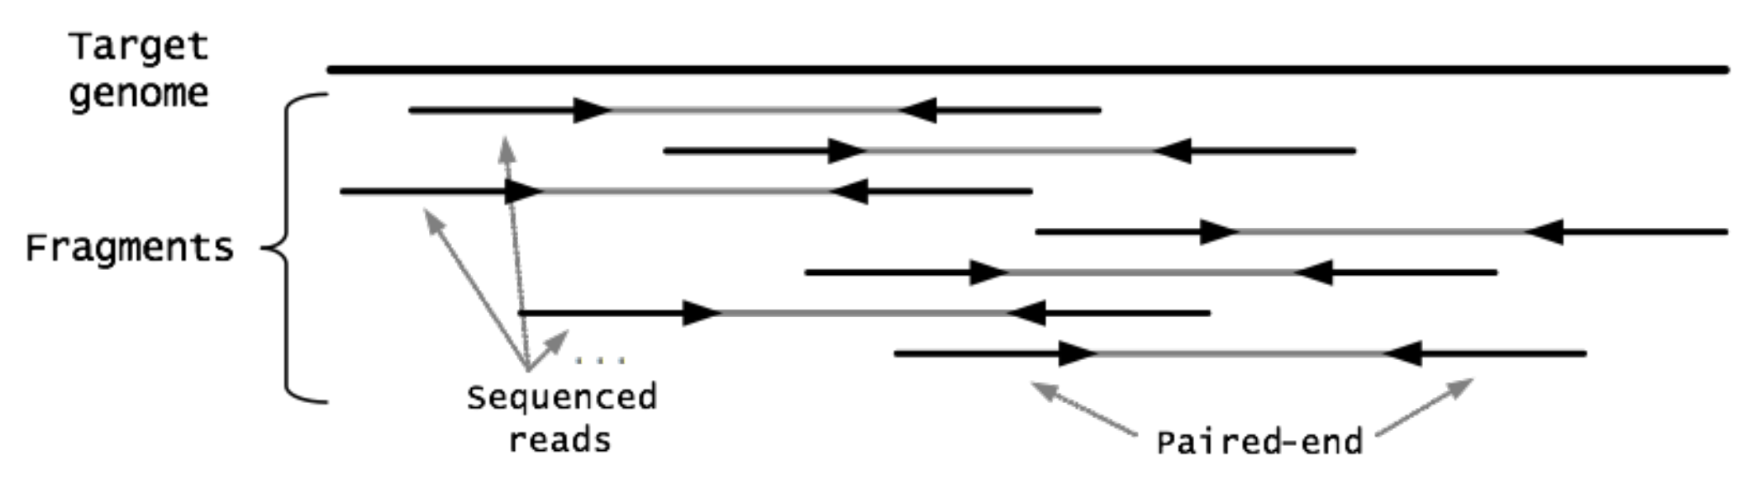
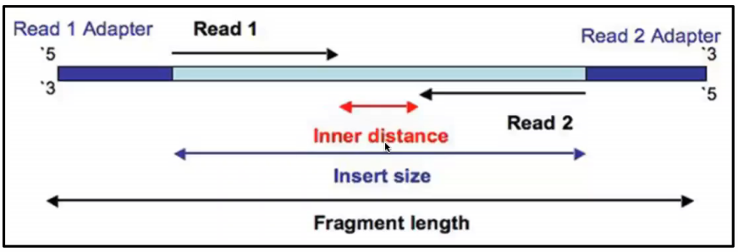
Paired-End Sequencing

Slide 9
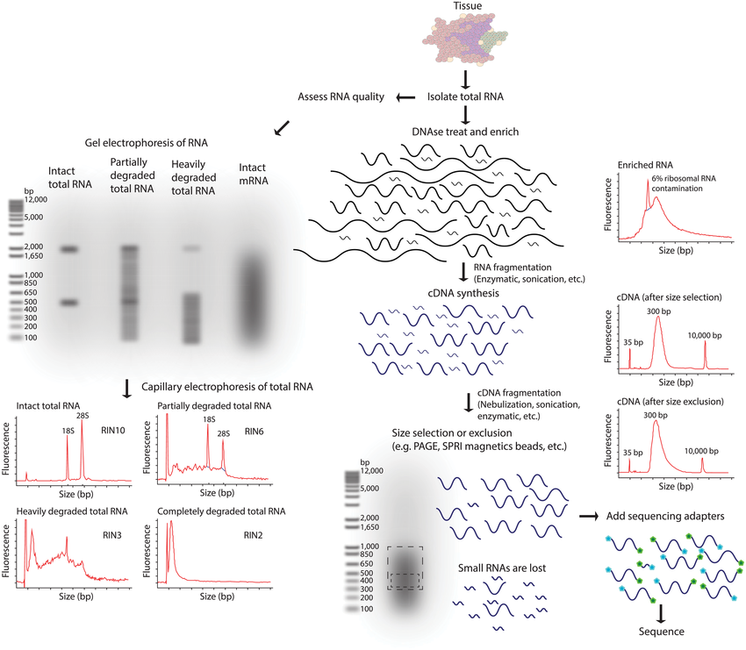
Fragment Size Selection
10.1371/journal.pcbi.1004393

Slide 10
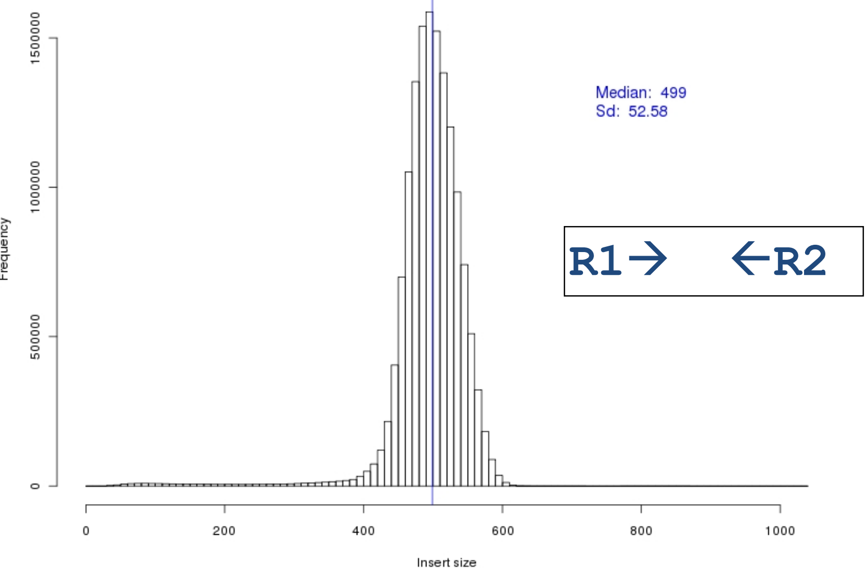
Paired-End Libraries

Slide 11
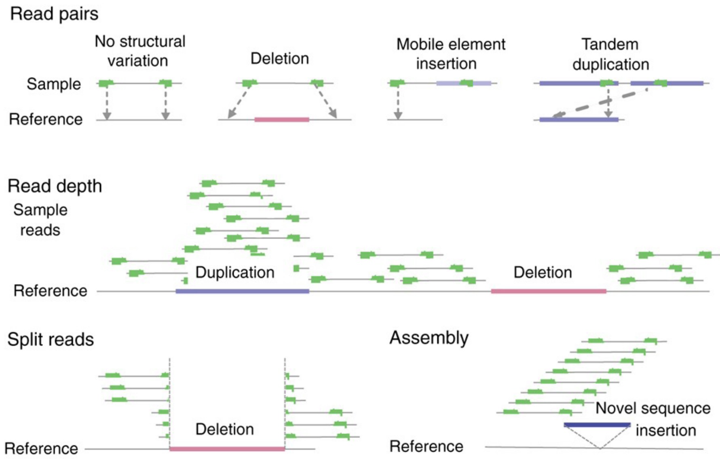
SV Discovery Approaches
Structural variation: the genome's hidden architecture. Baker M. Nat Methods. 2012 Jan 30;9(2):133-7

Slide 12
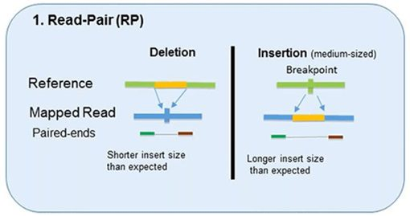
Read Pairs for detection of SVs
Pirooznia et al. (2015) Front. Genet

Slide 13
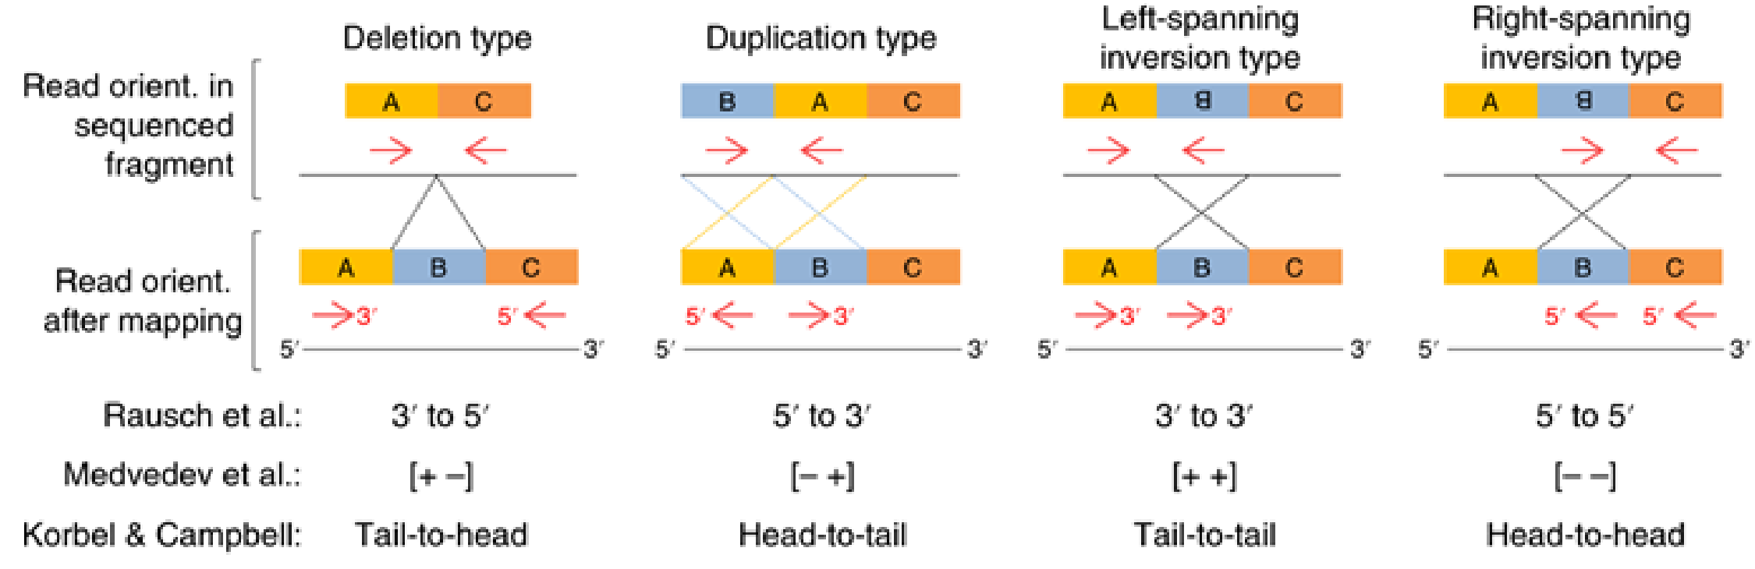
Read Pairs for detection of SVs
https://www.nature.com/articles/s41596-019-0234-7

Slide 14
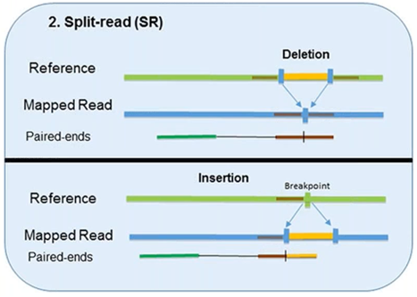
Read Split for detection of SVs
Pirooznia et al. (2015) Front. Genet

Slide 15
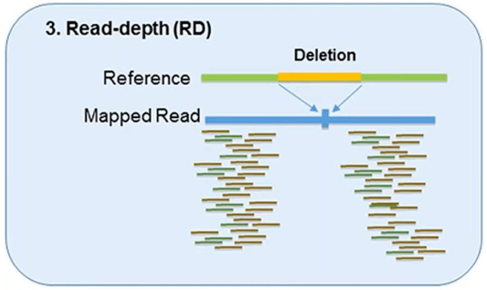
Read Depth for detection of SVs
Pirooznia et al. (2015) Front. Genet

Slide 16
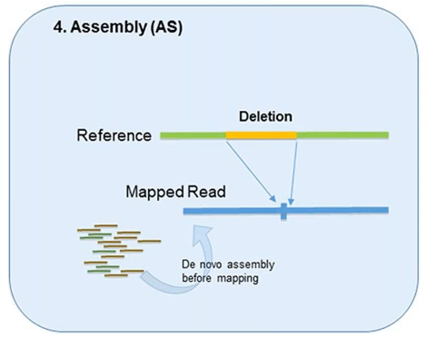
Denovo Assembly for detection of SVs
Pirooznia et al. (2015) Front. Genet

Slide 17
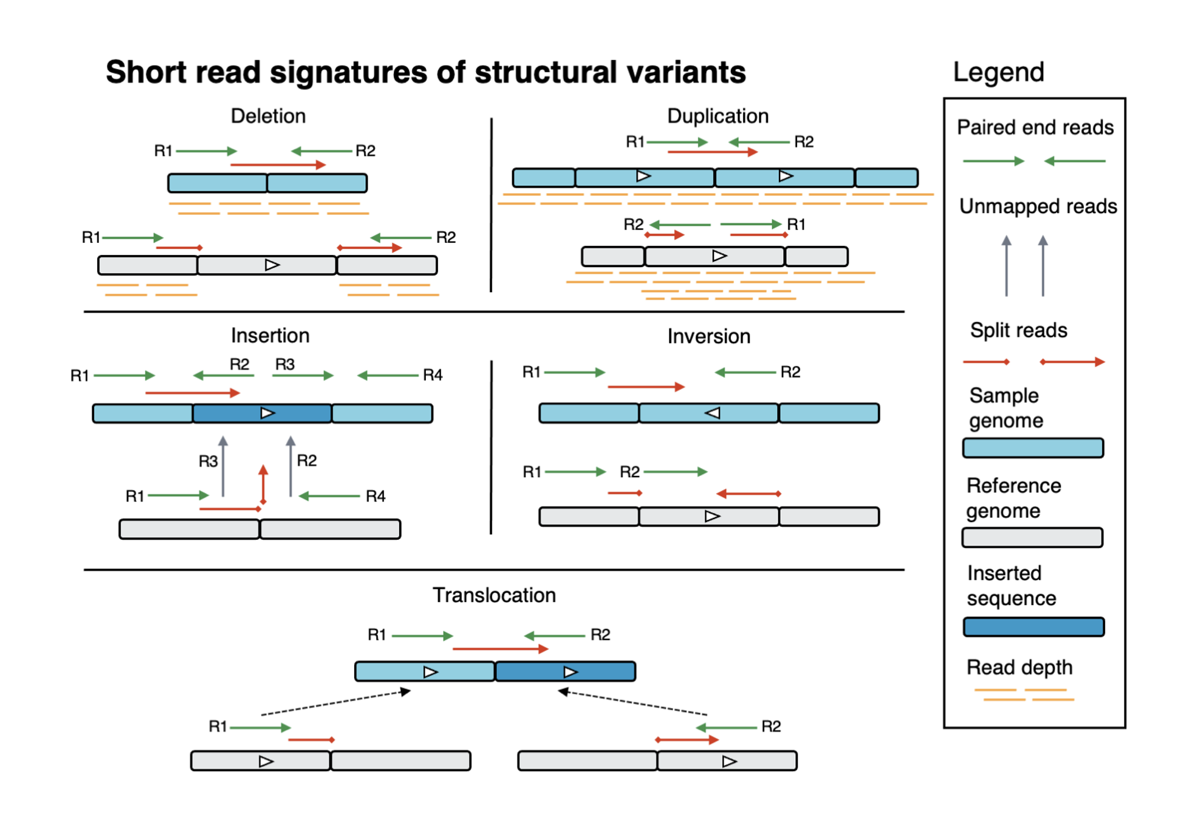
https://gatk.broadinstitute.org/hc/en-us/articles/9022476791323-Structural-Variants

Slide 18
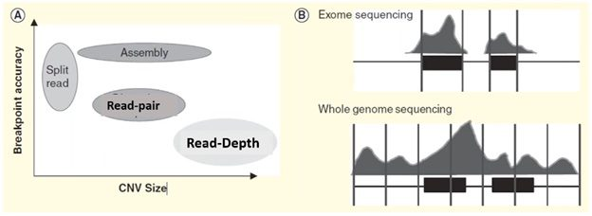
Methods for detection of SVs: CNV size vs Breakpoint Accuracy
Hehir-Kwa et al. (2015) Expert Rev Mol Diagn

Slide 19
Copy Number Variants (CNVs)

Slide 20
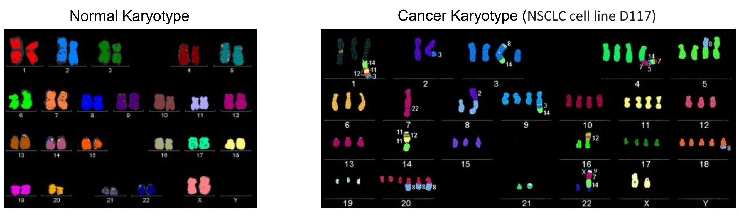
Human karyotype: Normal vs Cancer

Slide 21
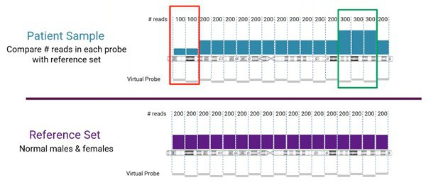
CNV detection: Normal vs Cancer
https://bionano.com/blogs/next-generation-sequencing-cnv-detection-analysis/

Slide 22
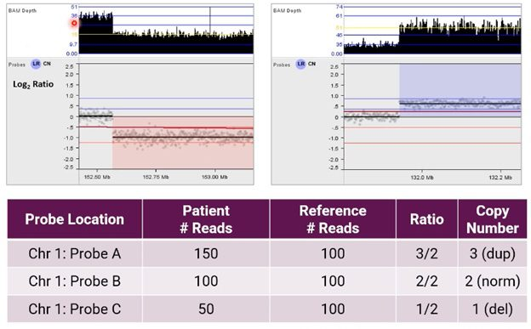
CNV detection: Normal vs Cancer
https://bionano.com/blogs/next-generation-sequencing-cnv-detection-analysis/

Slide 23
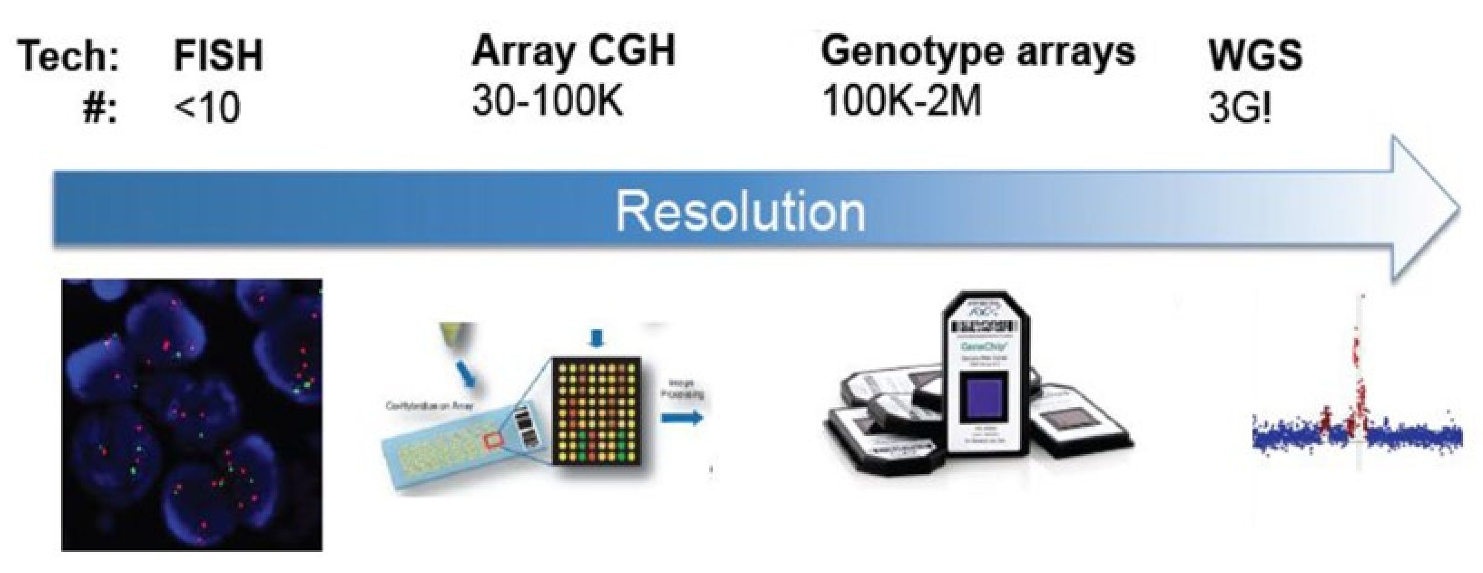
CNV detection technologies

Slide 24
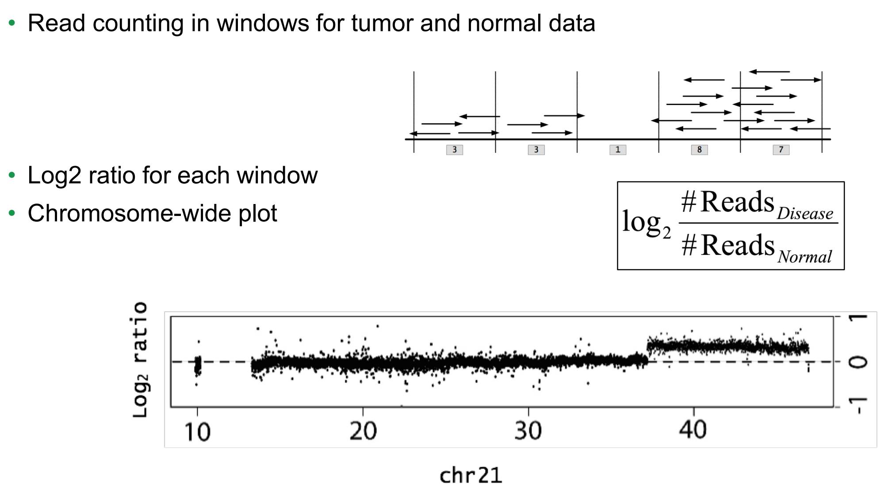
Tumor / Normal Read-Depth Ratio

Slide 25
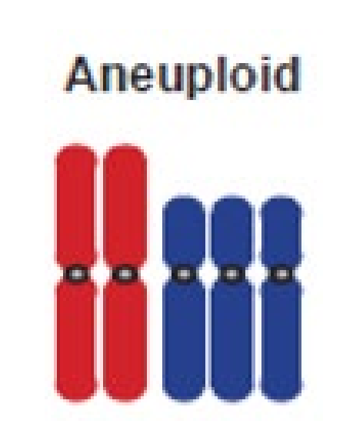
Copy Number Variants (CNVs)
• Can vary the gene dosage of a tumor suppressor or oncogene
• Aneuploidy or non-reciprocal translocations are one form of CNV
• Rare pathogenic germline CNVs can affect known cancer predisposition genes
• Recurrent deletions or duplications indicate a selective advantage

Slide 26
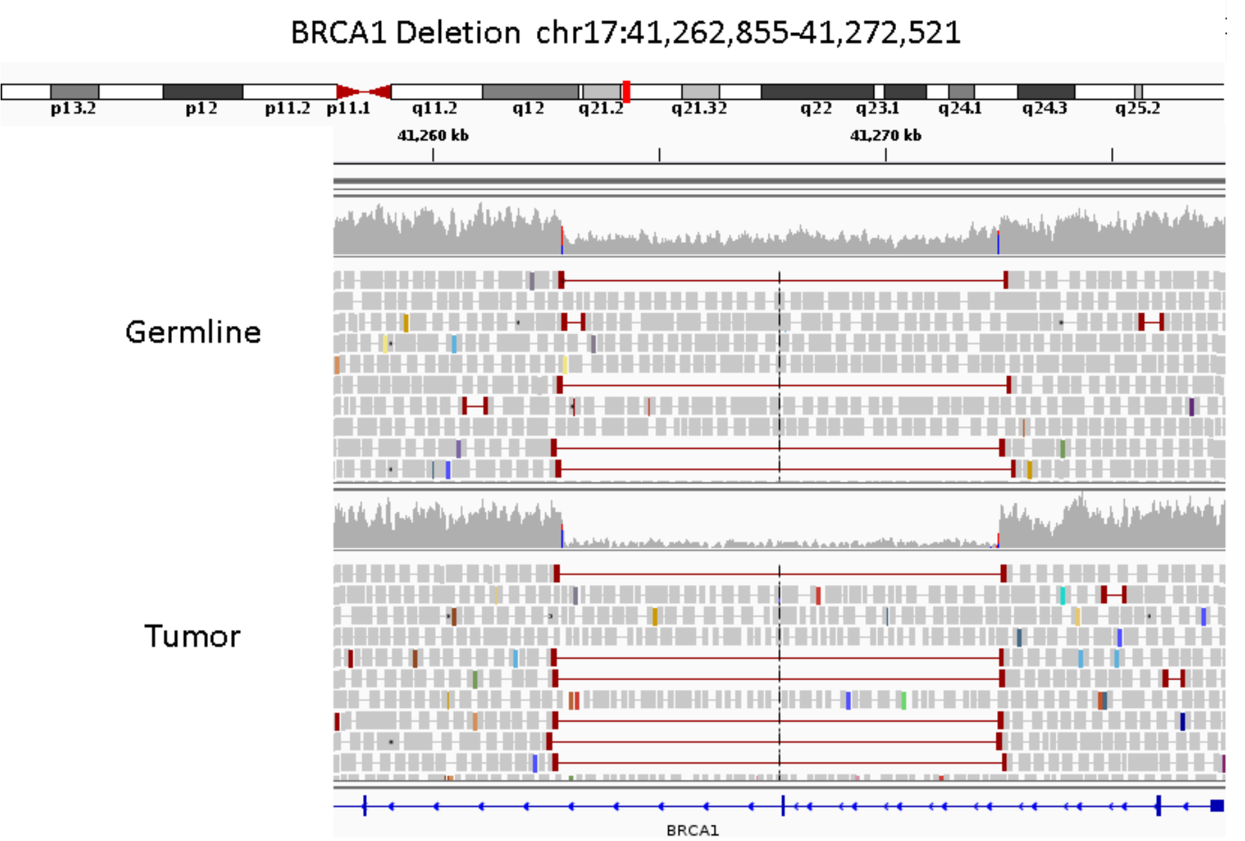
Copy Number Variants (CNVs)

Slide 27
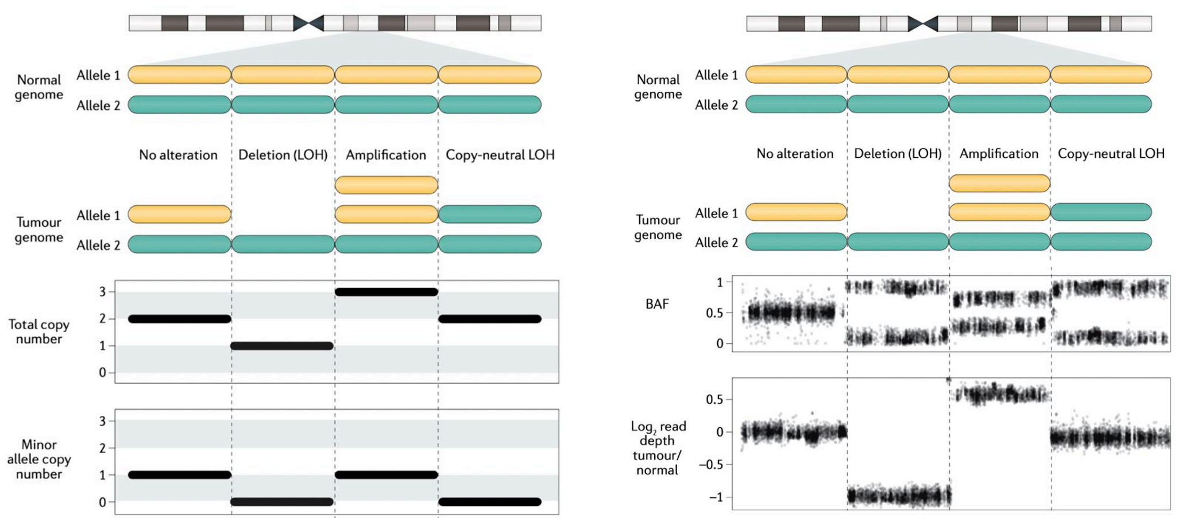
Copy Number Variants (CNVs)

Slide 28
Somatic Structural Variants

Slide 29
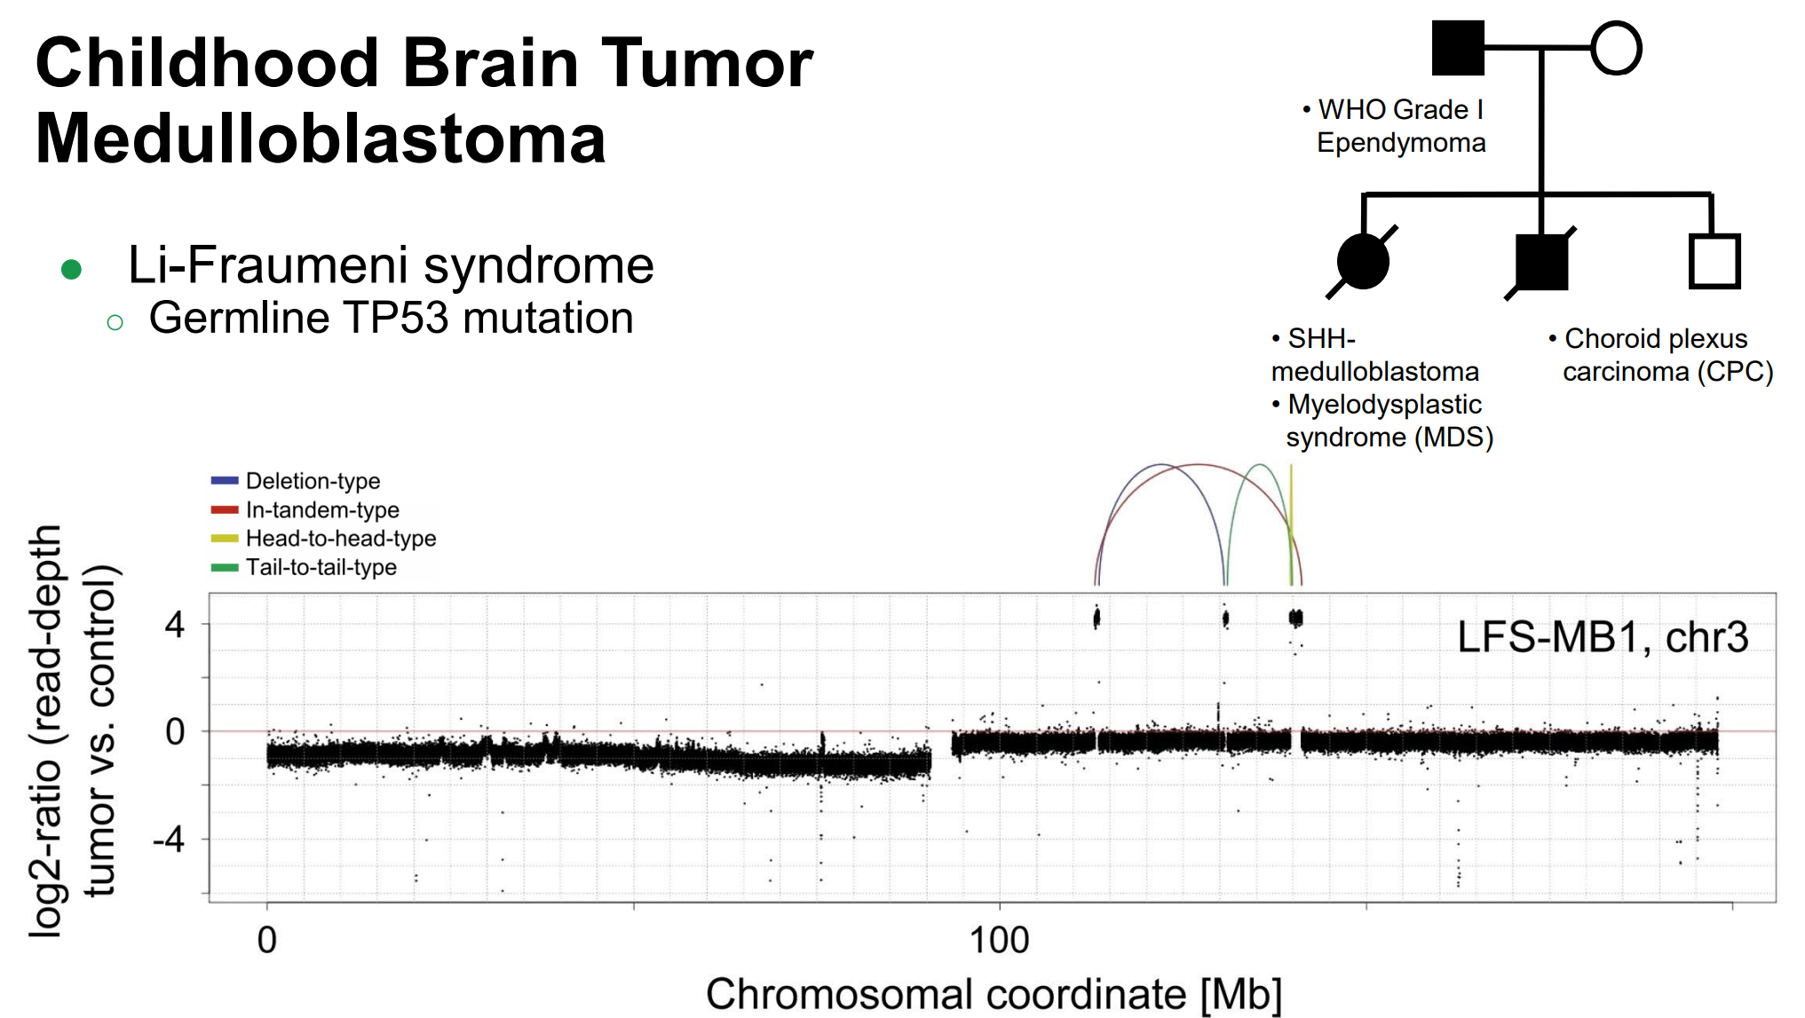

Slide 30
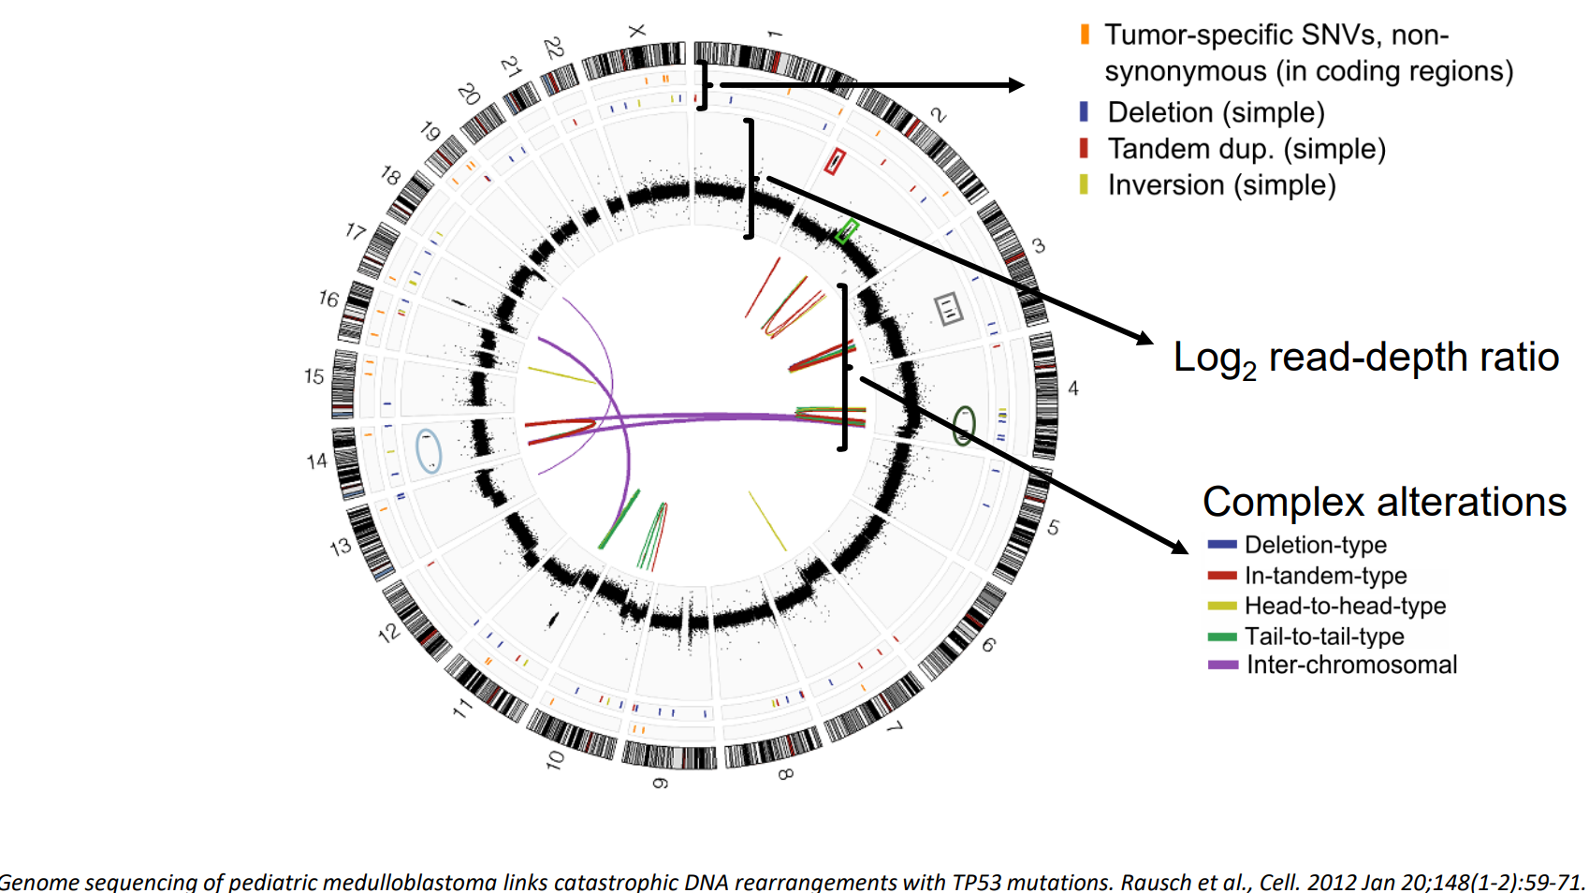
Somatic DNA alterations

Slide 31
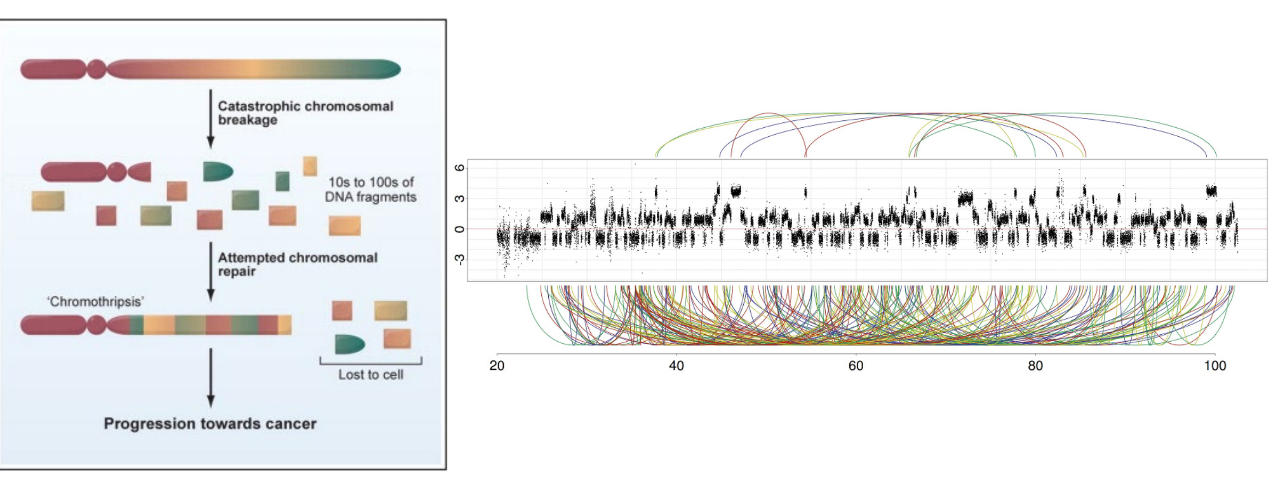
Chromothripsis
Stephens et al., Cell, 2011; Rausch et al., Cell, 2012

Slide 32
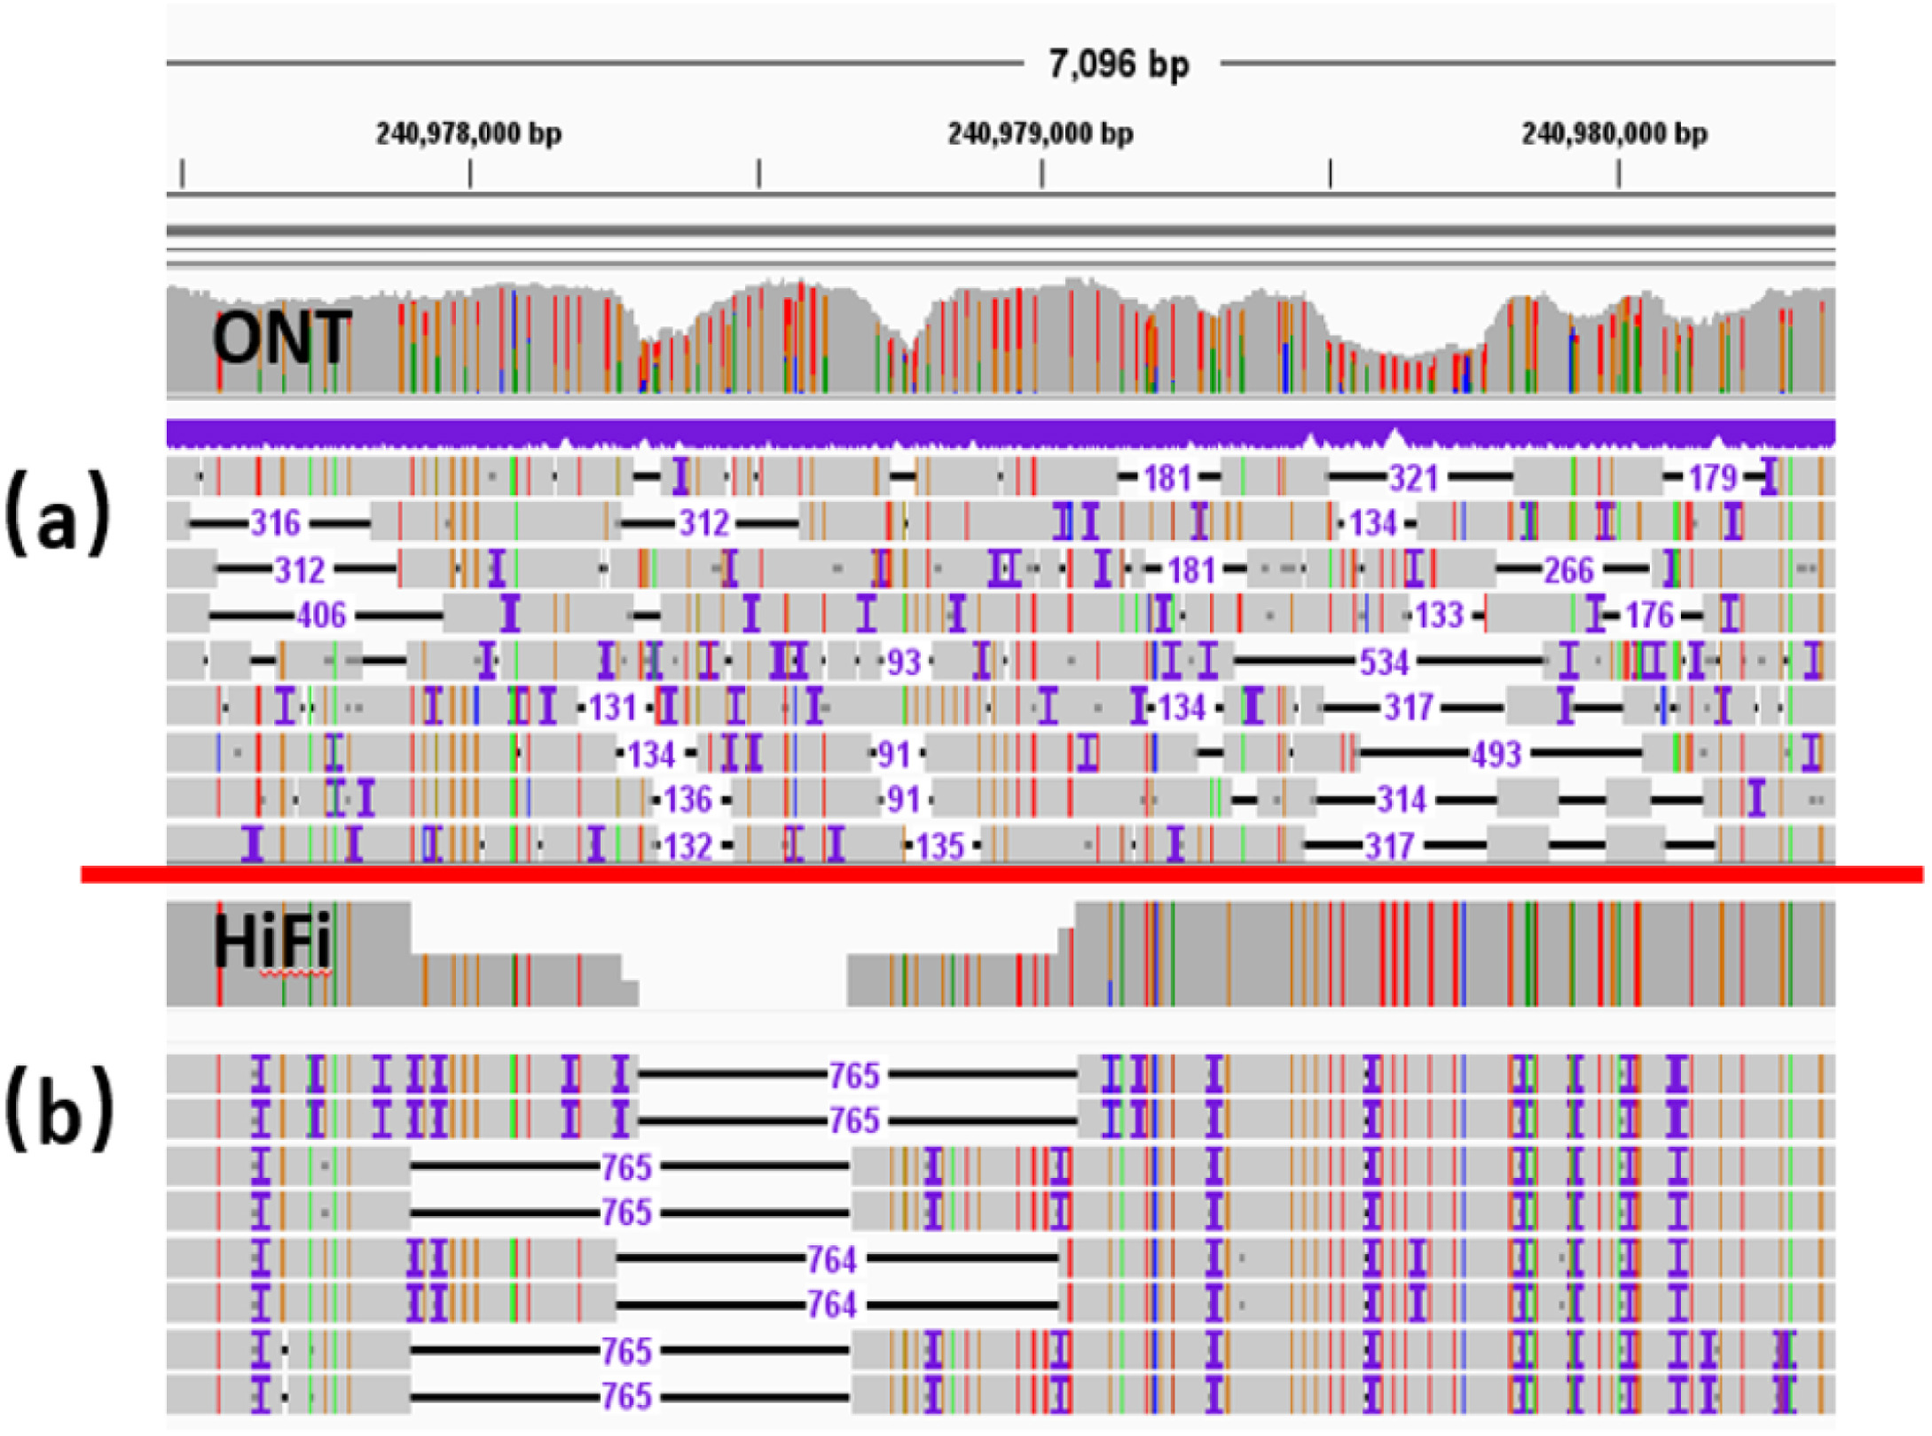
Pacbio vs ONT
https://www.sciencedirect.com/science/article/pii/S0010482523003086

Slide 33
Thank you!
Phuc Loi Luu, PhD
Email: Luu.p.loi@googlemail.com
Zalo: 090102182

